Slide 1
State
Property
Fund
of Ukraine
Small Privatization
News-letter
August 19,2020
More auctions are available at
privatization.gov.ua

Slide 2
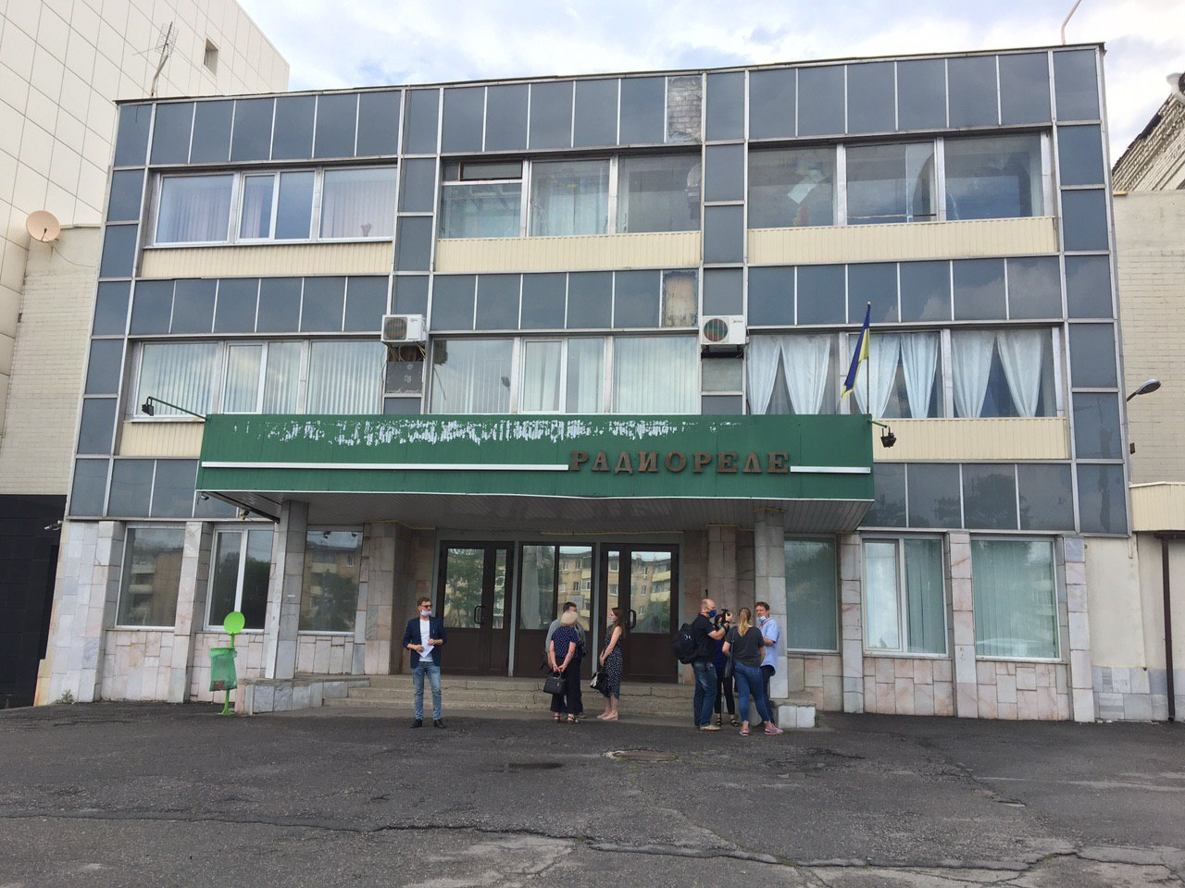
SE “Zavod “Radiorele”
Small Privatization
Key specifications of the object
Address: 181, Haharina Ave., Kharkiv city
State enterprise “Zavod “Radiorele” is one of the biggest enterprises in Ukraine and “the near abroad” that specializes on manufacture of electrical power distribution and control appliances. The total area of all enterprise’s buildings and constructions is 49,027.2 sq. m. A land plot where the enterprise is situated, is in a constant use and has a total area of 4.096 ha.
Volume of products (works, services) sales for 2017-2019 – UAH 77,076 thousand, including: export sales – UAH 48.429 thousand; for the 1st quarter of 2020 – UAH 2,672 thousand, including export sales - UAH 863 thousand.
Opening price
Auction date
₴ 97 153 500
25.08.2020
State
Property
Fund
of Ukraine
Take part in
an auction
Object
information

Slide 3
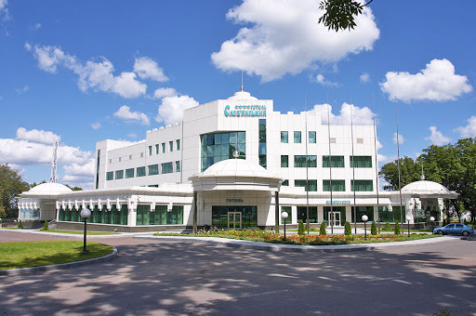
Hotel “Slovianskyi”
Small Privatization
Key specifications of the object
Address: 2a, Monastyrska St., Novhorod-Siverskyi town, Chernihiv region
Hotel Slovianskyi is situated on the picturesque bank of the Desna River, in close proximity to the Spaso-Preobrazhenskyi Monastery (XI – XII century). Novhorod-Siverskyi is a city of a legendary prince Ihor Sviatoslavovych, where there are a lot of cultural and historical heritage sites . Novhorod-Siverskyi is a one of the most tourist attractive cities of Ukraine.
It is available for guests 30 rooms, including room types: standard, junior suite, suite, apartment. Each room equipped with air conditioner, safe and private bathroom with 24-hour water supply. For guests convenience there are electronic locks, satellite tv and internet access in all rooms. Hotel’s conference room has capacity of 40 persons and it is equipped with all necessary for holding the conference, business meetings, corporate and private events. The hotel has a restaurant with two halls: a large one, for 100 places, and a small one, for 30 places. The complex includes: beauty salon, gym, billiard club, turkish bath, sauna with pool, disco bar for 75 persons.
The object’s total area – 4,883.9 м². A land plot under the building is not formed. The hotel is situated in a distance of 2 km from a bus station. Distance to Chernihiv city is 171 km.
Opening price
Auction date
₴57 717 486
27.08.2020
State
Property
Fund
of Ukraine
Take part in
an auction
Object
information

Slide 4
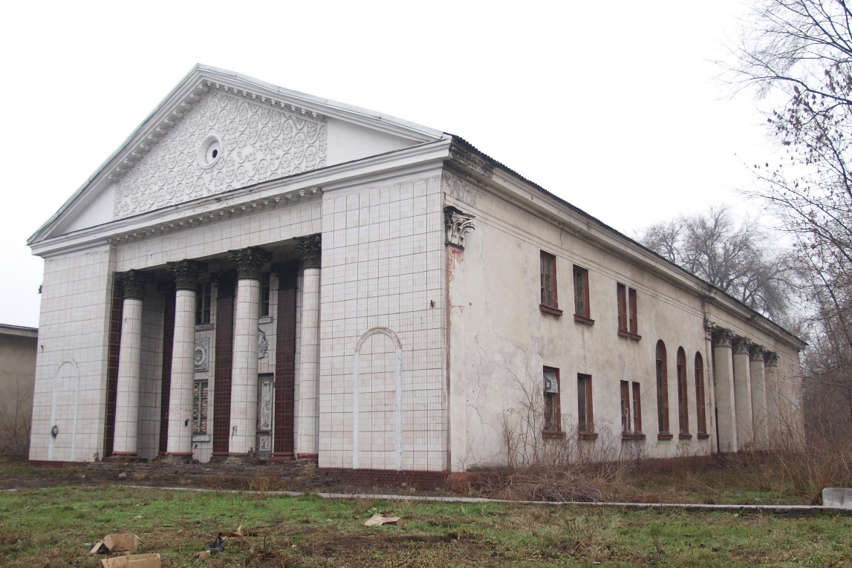
Club Building
Small Privatization
Key specifications of the object
Address: 2, Zavodska St., Kamianske town, Dnipropetrovsk region
The object is a two-storey building of club with a total area of 757.5 sq. m.; (foundation - slag concrete; walls – cinder block; floor - ½ metal slabs, ½ boards, slate roof); annex (slag concrete foundation, cinder block walls, concrete floor, slate roof), and slag concrete porches. The club building contains foyer, hall, rooms, scenery storages and etc.
State registration of the property right dated 04.05.2017, registration number of the real estate object - 1242246312104.
Opening price
Auction date
₴ 287 355
28.08.2020
State
Property
Fund
of Ukraine
Take part in
an auction
Object
information

Slide 5
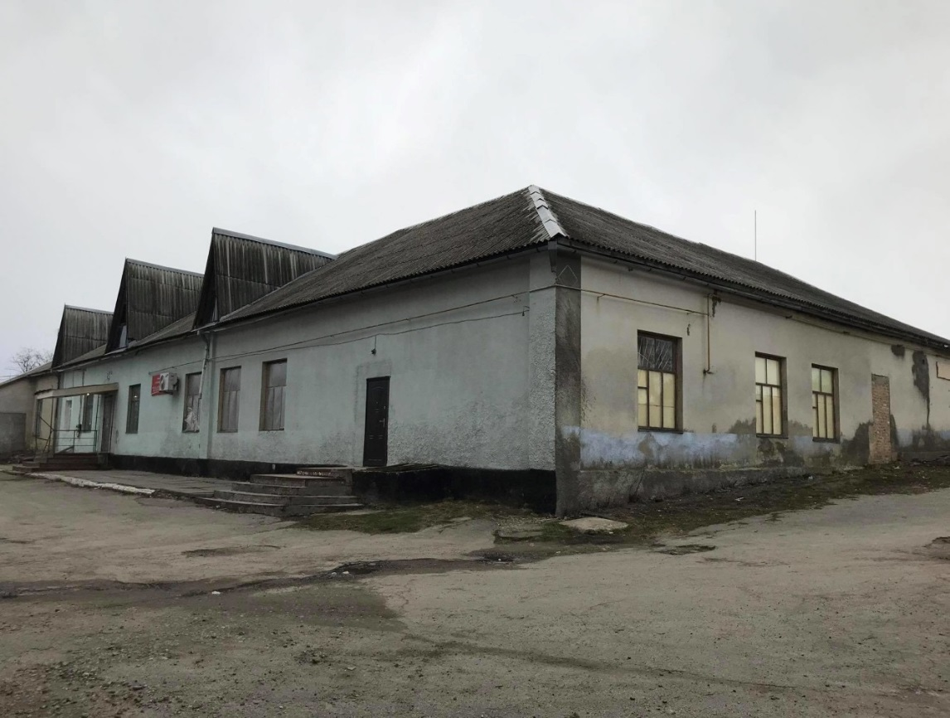
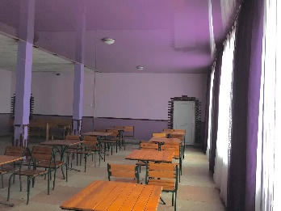
Canteen’s non-residential premises
Small Privatization
Key specifications of the object
Adress: 6, Zavodska St., Luka village, Tarashchanskyi district, Kyiv region
Canteen’s premises with a total area of 430.1 sq. m. that don’t include in the authorized capital of JSC “Luchanskyi Sugar Plant”. Year of construction – 1924. It’s a one-storey building. Main construction elements: foundation – quarried stone; walls – slag, coated with brick; partitions – wooden boards; overlapping – wooden beams; wooden roll; floor – asbestos and plywood; openings – wood.
Elements of engineering infrastructure: water heating; electricity supply; gas supply.
Opening price
Auction date
₴370 200
31.08.2020
State
Property
Fund
of Ukraine
Take part in
an auction
Object
information

Slide 6
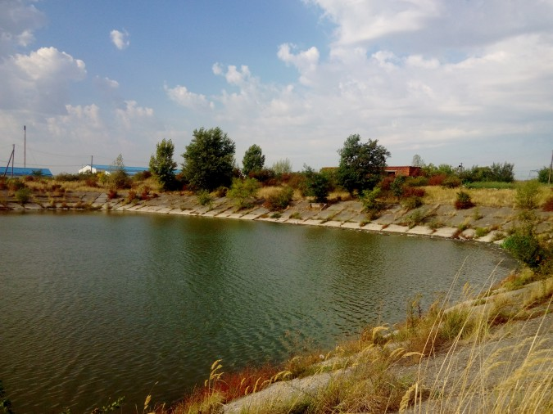
Sewer collector
Small Privatization
Key specifications of the object
Address: 2б, Trudova St., Rozivka village, Uzhhorodskyi district, Zakarpattia region
The object of unfinished construction includes: a building of a sewage pumping station with a total area of 127.4 sq. m; a sewer reservoir with a total area of 13590.0 sq. m; a distribution chamber with an area of 43.6 sq. m; a receiving chamber with an area of 16.8 sq. m; sand platforms (reservoirs) with a total area of 3402.0 sq. m; distribution station with an area of 67.2 sq. m; pumping station of domestic drain; pavement with an area of 594.0 sq. m. Object is located in the industrial area on the land plot of 3.64 hectares. The construction readiness is – 75%. The technical condition of the object is unsatisfactory.
Opening price
Auction date
₴3 526 383
31.08.2020
State
Property
Fund
of Ukraine
Take part in
an auction
Object
information

Slide 7
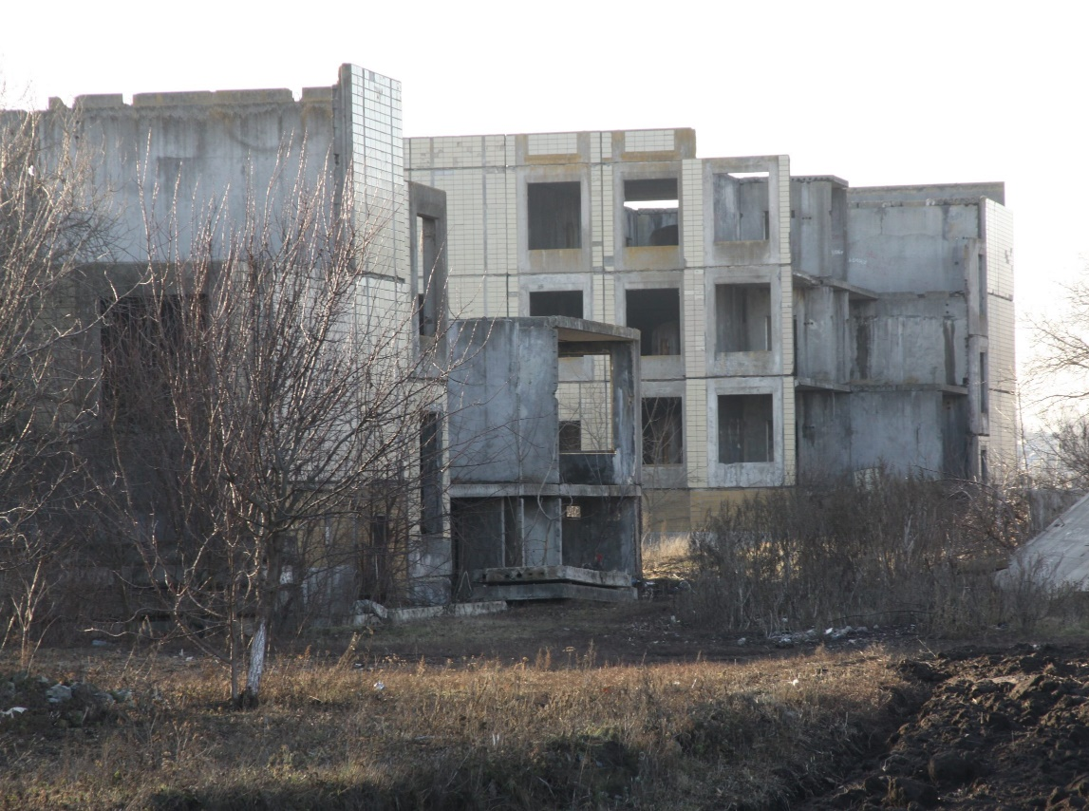
Object of Unfinished Construction is a High School
Small Privatization
Key specifications of the object
Address: 103, Tsumbala Serhiia (Radianska) St., Stavyscha small town, Kyiv region
The object of unfinished construction is a three-storey frame structure with a basement. Building of the object was begun in late 1992 and stopped in April 1995. Exterior walls and interior partitions are made of reinforced concrete panels and bricks. The foundation is concrete. Floors - reinforced concrete hollow panels. There is no roof. The floor is concrete, not decorated, there is no coating. Finishing of window and door openings - absent. Finishing works of internal premises were not carried out. There are no elements of engineering support. The construction readiness of the object is 21%.
The object is located on the second line of the building, the access roads to the building are dirt. The surrounding area is not tidy, not guarded, there is no fence.
The land plot was not allocated separately, land cadastral documentation for the land plot was not developed.
Opening price
Auction date
₴2 475 042
01.09.2020
State
Property
Fund
of Ukraine
Take part in
an auction
Object
information

Slide 8
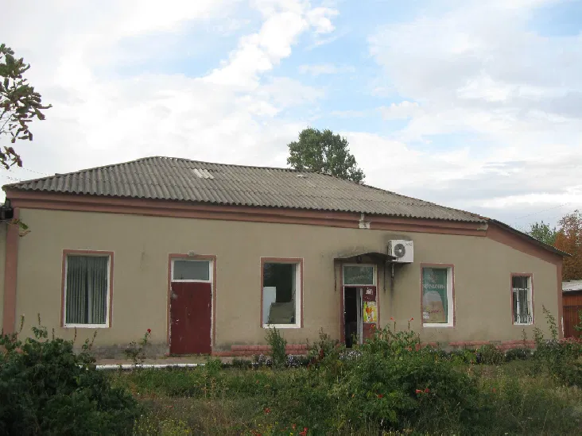
Shop Building
Small Privatization
Key specifications of the object
Address : 92-а, Bochkovycha St., Podilsk town, Odesa region
The object is non-residential premises with a total area of 252.0 sq. m., which are used for a shop. It’s one-storey building, in which these premises are located, was built in 1956: walls made of shell rock, floors - made of reinforced concrete slabs; consists of thirteen adjoining premises. The premises are provided with electricity, water supply and sewerage, are in satisfactory condition.
Opening price
Auction date
₴696 292
02.09.2020
State
Property
Fund
of Ukraine
Take part in
an auction
Object
information

Slide 9
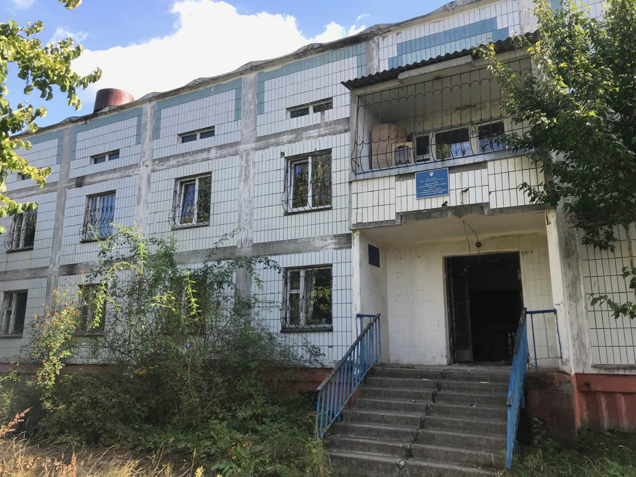
Premises on the First Floor of the Building
Small Privatization
Key specifications of the object
Address: 65, Evropeyska St., Uman town, Cherkasy region
Premises are on the first floor of a building with a total area of ​​107.9 sq. m. Non-residential premises (6-rooms) are located on the first floor of a two-storey office building. The premises have not been used for a long time, the physical condition is not satisfactory. The building is located on the outskirts of the town; communication networks are connected to the building. The land plot on which the administrative building is located is accounted for according to Bila Tserkva KEV and belongs to the lands of industry, transport, communications, energy, defense and other purposes; form of ownership - state; cadastral number is missing.
Opening price
Auction date
₴128 750
02.09.2020
State
Property
Fund
of Ukraine
Take part in
an auction
Object
information

Slide 10
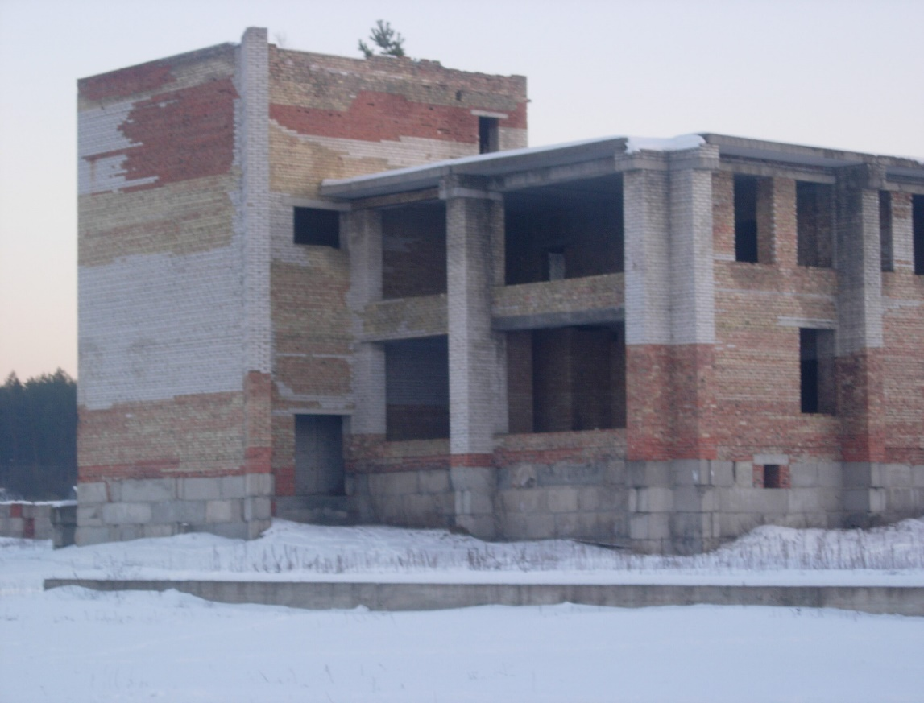
Object of Unfinished Construction is a House of Culture
Small Privatization
Key specifications of the object
Address: 4Д, Shevchenka St., Kodra small town, Makarivskyi district, Kyiv region
The building is two-storey, brick. The privatization object includes an unfinished basement, the first, second and third floors of the house of culture with a total area of ​​4655.7 sq. m. The degree of construction readiness of the object is 11%. Building materials and equipment that have not been handed over for installation are not available on the site. No conservation work was carried out. The erected structures were affected by precipitation, temperature changes and unauthorized dismantling by the population, which led to partial damage and destruction of the erected structures. The territory is not fenced, abandoned. There are no elements of engineering and sanitary support systems. The erected structural elements of the building are in a satisfactory condition.
Opening price
Auction date
₴293 300
02.09.2020
State
Property
Fund
of Ukraine
Take part in
an auction
Object
information

Slide 11
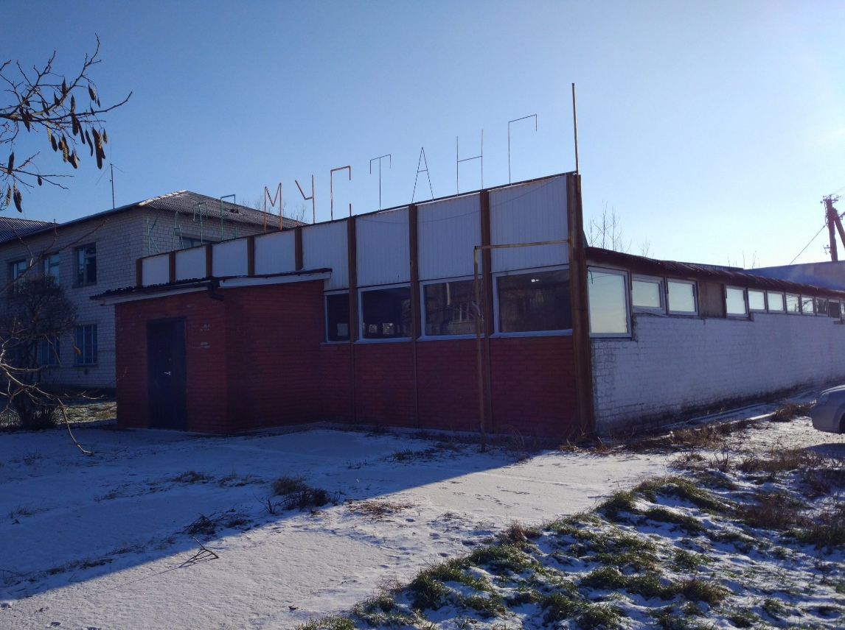
Non-residential Building - Canteen
Small Privatization
Key specifications of the object
Address: 22, Sviato-Mykolaivska St., Bziv village, Barushivskyi district, Kyiv region
The canteen building was built in 1979. According to the project's functional purpose, the building was built as a canteen building, which functioned only in the summer. In terms of capital, the building belongs to group IV: first it was a building with metal walls, then the walls were lined with brick. The building has two separate entrances to the premises located on the front and rear facades. Engineering communications - electricity, water supply. The fencing of the territory is made of reinforced concrete panels measuring 2.5x2.9 m. The area of ​​the fence is 64 sq. m. The general and physical condition of the main building elements of the building is satisfactory. Information about the land plot: the land plot is not allocated separately.
Opening price
Auction date
₴126 708
02.09.2020
State
Property
Fund
of Ukraine
Take part in
an auction
Object
information

Slide 12
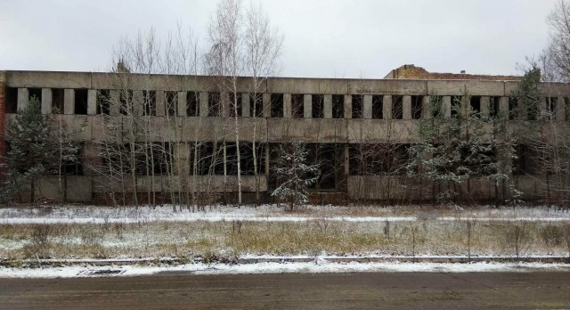
Factory - a Laundry and Dry Cleaning Company
Small Privatization
Key specifications of the object
Address: 2, Klenovyi passage, Slavutych town, Kyiv region
Object is unfinished construction. The walls are brick and partly concrete slabs. Partitions - brick. Floors - reinforced concrete panels. Finishing, roof, window and door openings are missing. The erected structural elements of the buildings are in a satisfactory condition. The area nearby is not tidy. There is no fence. The land plot was not allocated separately, land cadastral documentation for the land plot was not developed. There is no information about the balance holder.
The level of construction readiness is 33%. Registration number: at the stage of state registration.
Opening price
Auction date
₴372 500
04.09.2020
State
Property
Fund
of Ukraine
Take part in
an auction
Object
information

Slide 13
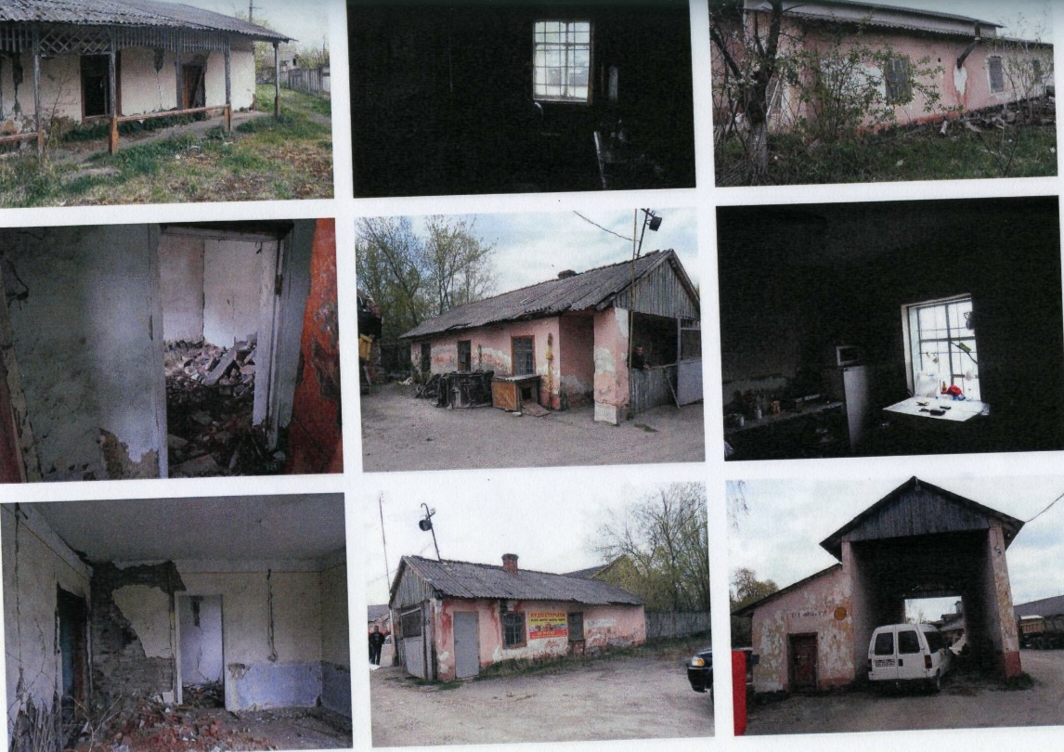
Group of inventory objects
Small Privatization
Key specifications of the object
Address: 258-Б, Stryiska St., Drohobuch town, Lviv region
Group of inventory objects as a part: asphalt platforms, weight automobile, deepened warehouse, office laboratory, machine shop, fence, air power line, fire depot and bath, fire depot, checkpoint, working tower, warehouse No. 1, warehouse No. 2, warehouse No. 3, warehouse No. 4, warehouse No. 5, warehouse No. 6, warehouse No. 8.
The total land area is 2.4983 ha. There is no information on the cadastral number for the land plot.
Opening price
Auction date
₴6 724 687
07.09.2020
State
Property
Fund
of Ukraine
Take part in
an auction
Object
information

Slide 14
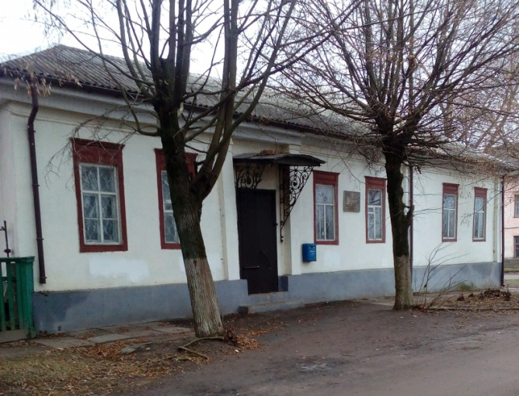
Group of Non-residential Buildings
Small Privatization
Key specifications of the object
Address: 13, Poshtova St., Novhorod-Siverskyi town, Chernihiv region
A group of non-residential buildings consists of: a non-residential building with a total area of 282.3 sq. m., brick foundation, wooden walls lined with bricks, roof made of asbestos sheets, available gas supply, electricity supply, drainage; garage with a total area of 35.9 sq. m. - one-storey, foundation, walls - brick, roof made of asbestos sheets, available electricity; toilet with a total area of 3 sq. m. - foundation, walls - brick, roof of asbestos sheets.
Opening price
Auction date
₴271 646
07.09.2020
State
Property
Fund
of Ukraine
Take part in
an auction
Object
information

Slide 15
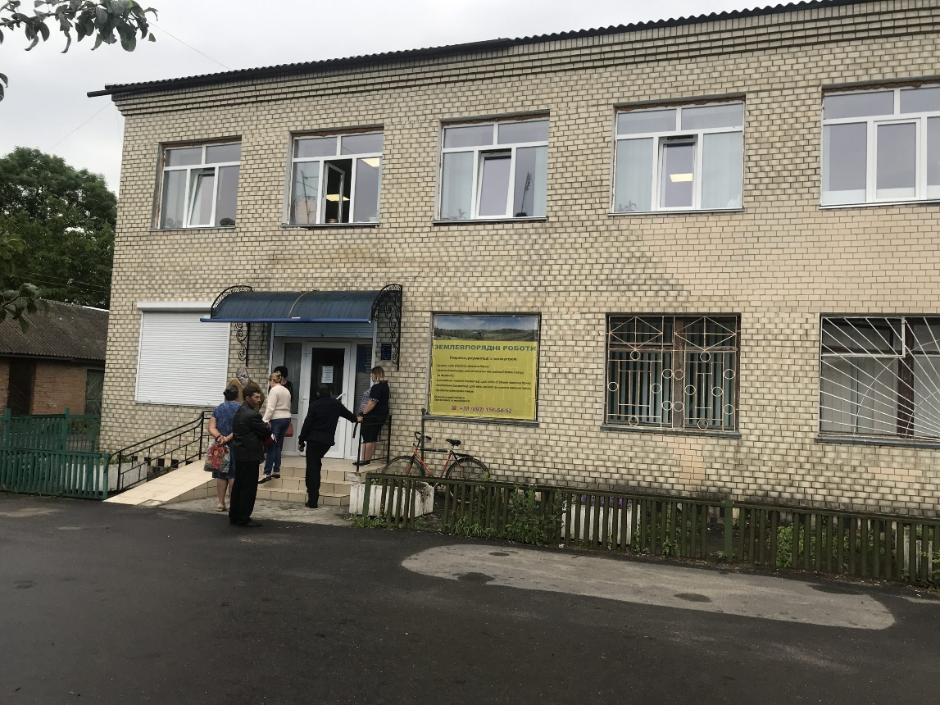
Administrative Building
Small Privatization
Key specifications of the object
Address: 2, Podilskyi lane, Starokostiantynivsk town, Khmelnytskyi region
Administrative building with a total area 491.8 sq. m. The foundation is stone, the walls are brick, the roof is slate, the floor is reinforced concrete, the floor is tile, linoleum. Available: water supply, sewerage, heating (water), electrification. This building is given in rent.
The right of permanent use is registered on the land plot.
Opening price
Auction date
₴1 075 675
08.09.2020
State
Property
Fund
of Ukraine
Take part in
an auction
Object
information

Slide 16
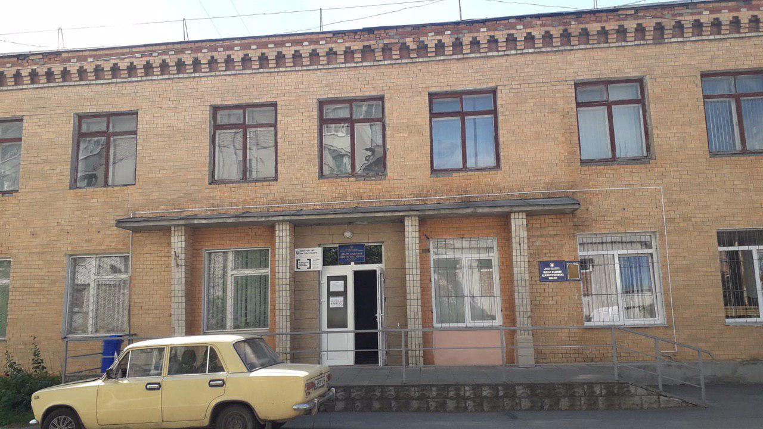
Administrative Building
Small Privatization
Key specifications of the object
Address: 8а, Lysenka St., Volochysk town, Volochunskyi district, Khmelnytskyi region
Administrative building with a total area of 426.9 sq. m. The ownership of the object is registered with the State of Ukraine in the person of the State Statistics Service of Ukraine. The object is located on a land plot of 510 sq. m. This building is given in rent.
Opening price
Auction date
₴419 901
08.09.2020
State
Property
Fund
of Ukraine
Take part in
an auction
Object
information

Slide 17
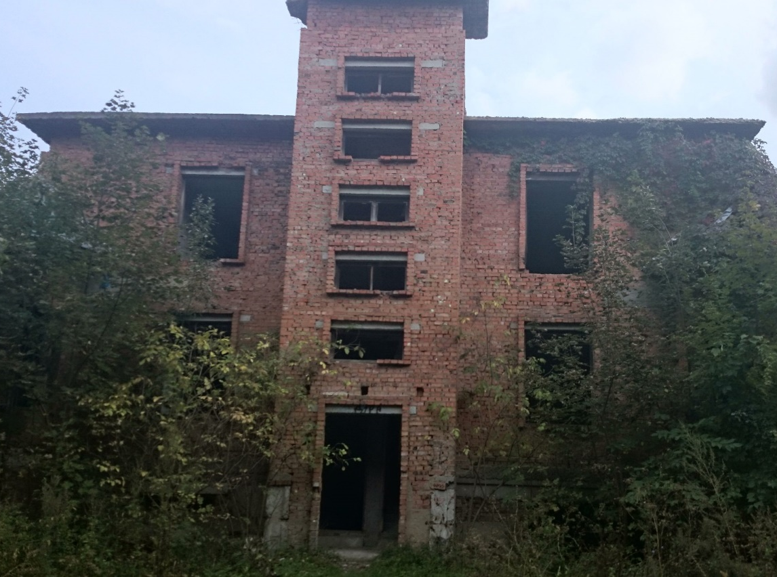
Complex of Buildings
Small Privatization
Key specifications of the object
Address: 46, Lisova St., Lisovi Hrynivtsi village, Khmelnytskyi region
The object of unfinished construction is a complex of buildings (administrative building, boiler room, garage). The building area is 380.8 sq. m. (boiler room and garage are one-storey, administrative building is two-storey). All buildings are brick, floors - reinforced concrete panels. The object is accounted for on the balance sheet of SE “Khmelnytskyi Forestry”. The percentage of construction readiness is 40%. The book value of the object is UAH 644 thousand.
Opening price
Auction date
₴322 187
09.09.2020
State
Property
Fund
of Ukraine
Take part in
an auction
Object
information

Slide 18
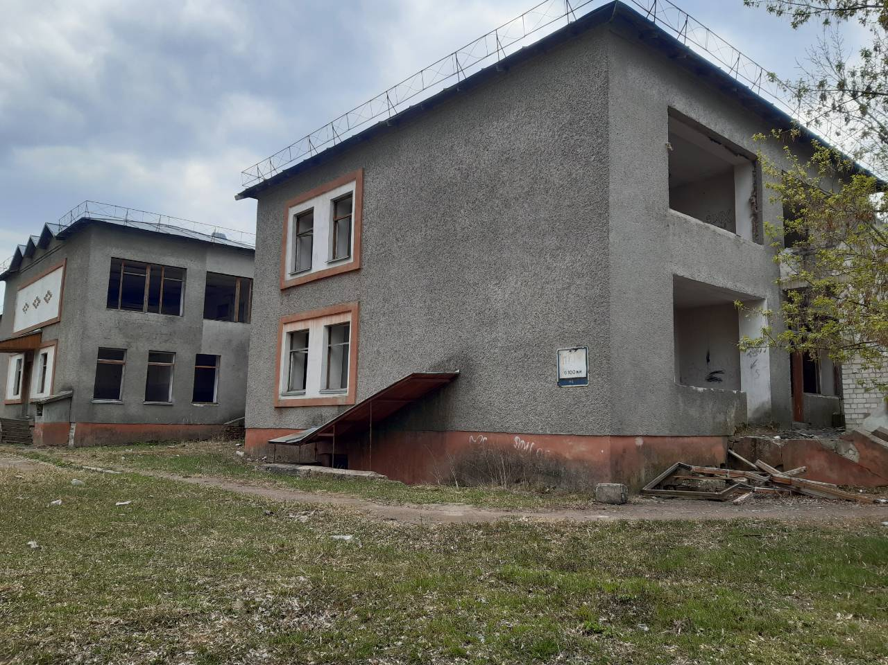
Building of the Former Kindergarten
Small Privatization
Key specifications of the object
Address : 6-А, Myru St., Ivnytsia village, Andrushivskyi district, Zhytomyr region
The building of the former kindergarten with a total area of 2,511.5 sq. m. The balance holder is PrJSC “Firm “Zhytomyrinvest”, a two-storey brick building with a basement located in the center of the settlement, which has not been used for a long time.
Opening price
Auction date
₴235 718
09.09.2020
State
Property
Fund
of Ukraine
Take part in
an auction
Object
information

Slide 19
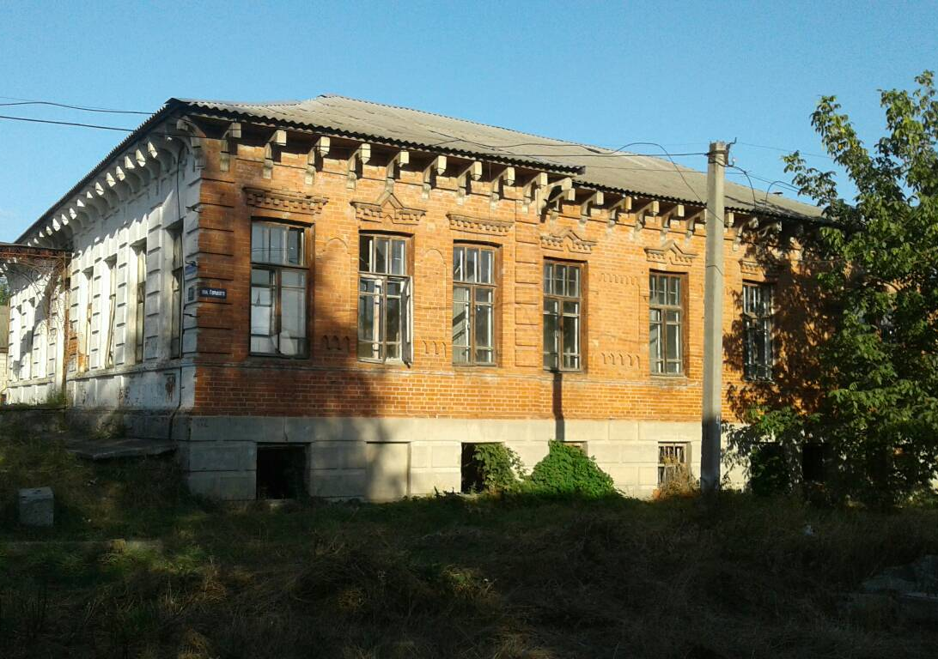
Administrative Building
Small Privatization
Key specifications of the object
Address : 83, Bielovaska (Lenina) St., Krasnohrad town, Kharkiv region
Non-residential administrative building, one-storey with a basement with a total area of 277.3 sq. m. (basement area 56.5 sq. m.), building area - 305.0 sq. m. Year of construction - 1905. Not used for its intended purpose. The technical condition is satisfactory. Land plot of 0.0539 ha.
The non-residential building of garage is one-storey with a total area of 24.8 sq. m., building area - 31.5 sq. m. Year of construction - 1976. Not used for its intended purpose. The technical condition is satisfactory. The land plot is 0.0031 ha.
Opening price
Auction date
₴708 000
10.09.2020
State
Property
Fund
of Ukraine
Take part in
an auction
Object
information

Slide 20
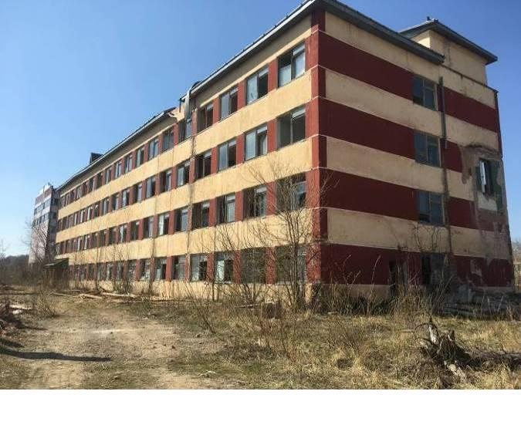
Group of Inventory Objects
Small Privatization
Key specifications of the object
Address: 721, Drohobytska St., Boryslav town, Lviv region
The group of inventory objects consists of: the premises of the former medical center with an area of 131.3 sq. m., sanitary pass to the canteen with a total area of 31.2 sq. m., a greenhouse with a total area of 93.5 sq. m., vegetable storage. The object is located on the territory of JSC “Hallak”, on the outskirts of Boryslav town, an industrial area of the town. As of today, the company is not operating.
Opening price
Auction date
₴327 475
11.09.2020
State
Property
Fund
of Ukraine
Take part in
an auction
Object
information

Slide 21
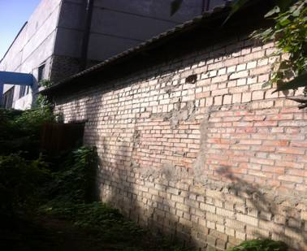
Sauna with an area of 51.7 sq. m.
Small Privatization
Key specifications of the object
Address: 34, Biletskoho Akademika St., Kyiv city
Object size: 51.7 sq. m. The house is one-storey, non-residential purpose, brick, attached to the technological building (boiler room), the owner of which is PE “Ros”. The foundation is tape, from reinforced concrete plates, external walls brick, partitions brick, overlapping reinforced concrete, a roof - asbestos-cement sheets. Year of commissioning - 1996.
Opening price
Auction date
₴233 290
11.09.2020
State
Property
Fund
of Ukraine
Take part in
an auction
Object
information

